Slide 1

Certichain
Software Requirements Specification Presentation
Group 10

Slide 2
Certichain
Our Team
2324816
2324788
2324812
A. A. M. N. Perera
I. Hassaan
N. Wickramasinghe
Project Manager
Start-Up Manager
Quality Manager
2321608
2323507
Shenuka Fernando
P. A. Gunawardhana
Risk Manager
Scheduling Manager

Slide 3

Certichain
Content
Introduction
As Is System
To Be System
System Architecture Diagram
User Interfaces
Use Case Diagram
ER Diagram
Functional Requirements
Technologies
Operating Environment
Non - Functional Requirements

Slide 4




Centralized Database
Certichain
Introduction
Problem Statement
Proposed Solution:
Currently, there is no system in place for certificate holders to verify the authenticity of their certificates issued by Santha Rita Institute, leading to potential misuse and forgery.
The prevalence of unauthorized certificate duplication and creation of false certificates presents a critical challenge to maintaining the integrity of certification records.
Relying on a centralized system for certificate storage exposes the institution to risks such as certificate forging, illegal access, and system breakdowns.
Implementation of a blockchain-powered web application specifically designed to securely store digital certificates utilizing blockchain technology.
Students
Santha Ritha Institute
Printed Certificate

Slide 5



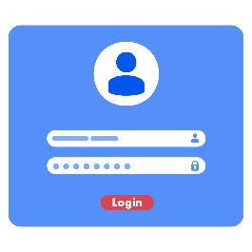




IPFS
Certichain
As Is System
Centralized Database
Santha Ritha Institute
Santha Ritha Institute
Students
Digital Certificate
Student ID / QR
Login
Dashboard
Upload Data
Off Chain
Blockchain

Slide 6
Certichain
To Be System
IPFS
Content ID
Login
Store Data
Validate Data
Santha Ritha Institute
Upload Data
Off Chain
Student ID / QR
Mint Certificate
Dashboard
Blockchain

Slide 7
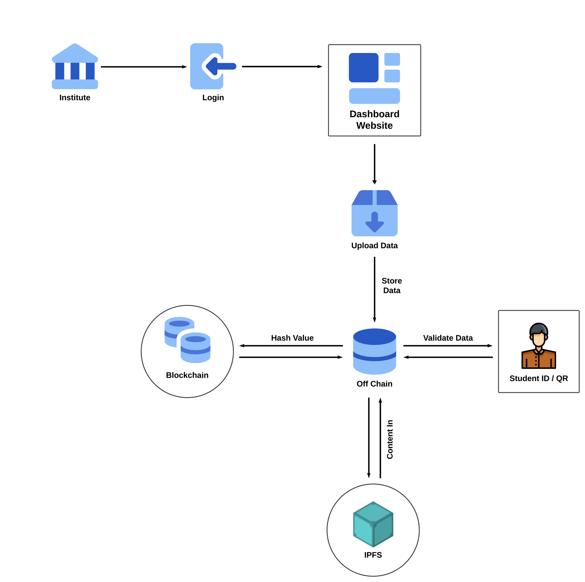
Certichain
System
Architecture Diagram

Slide 8
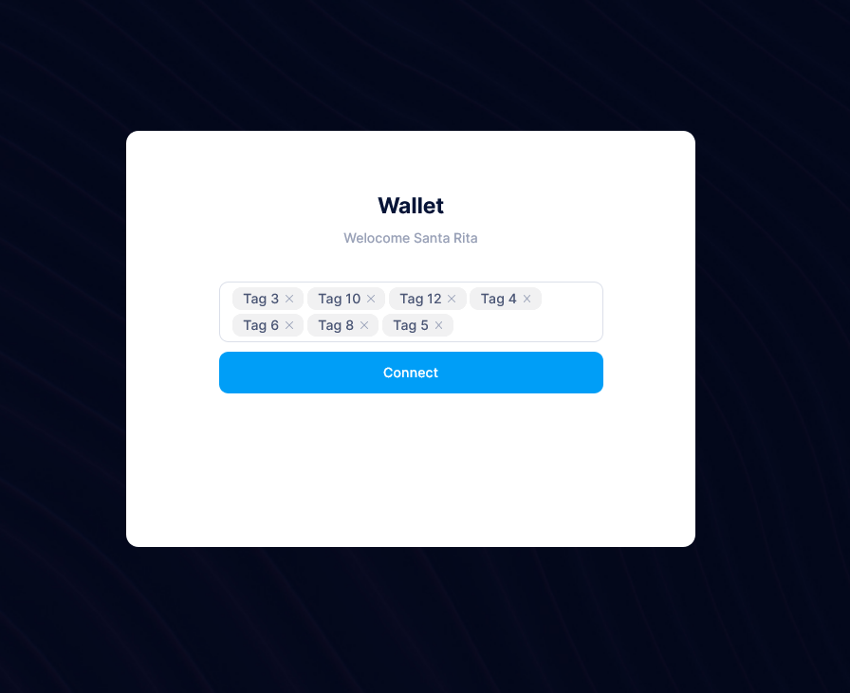
Certichain
User Interfaces

Slide 9
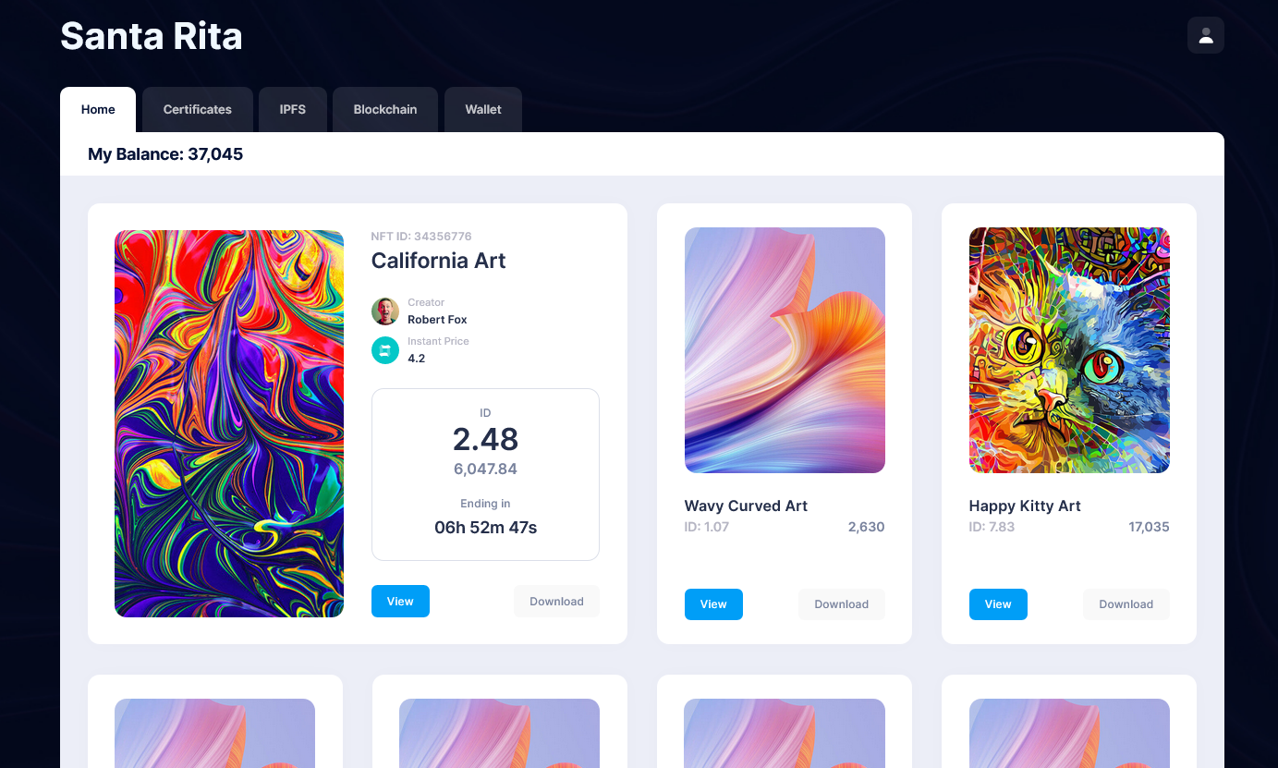
Certichain
User Interfaces

Slide 10
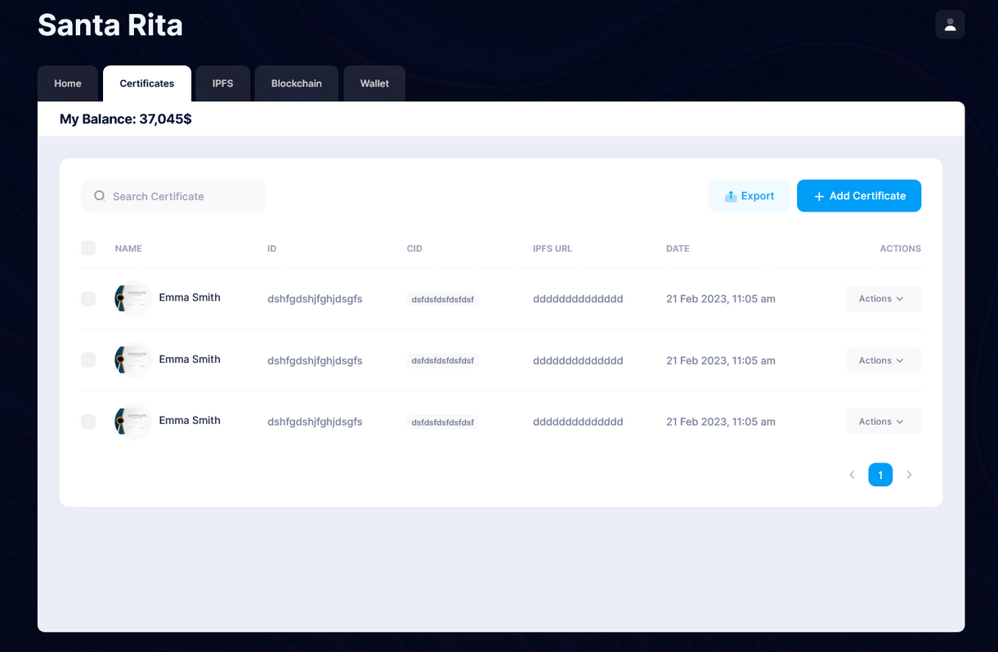
Certichain
User Interfaces

Slide 11
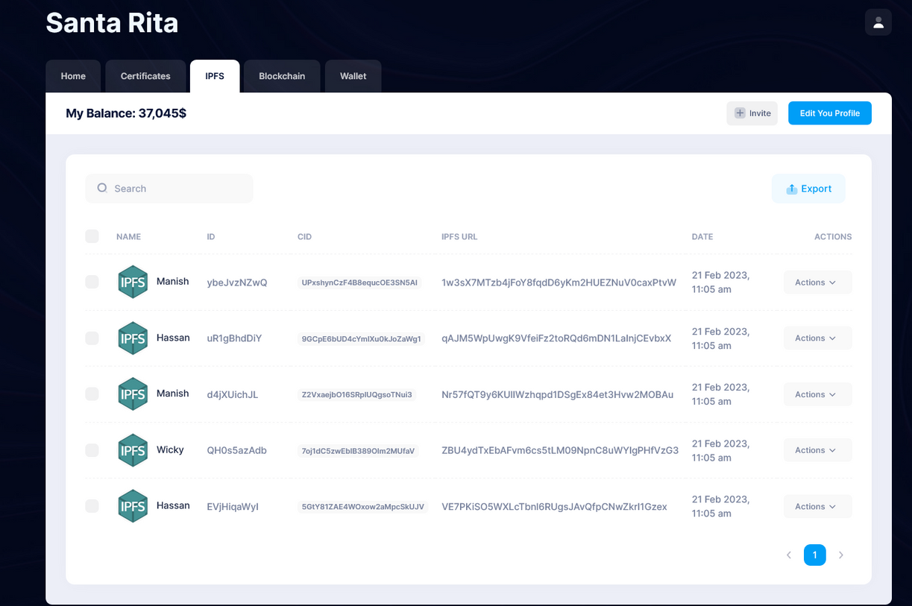
Certichain
User Interfaces

Slide 12
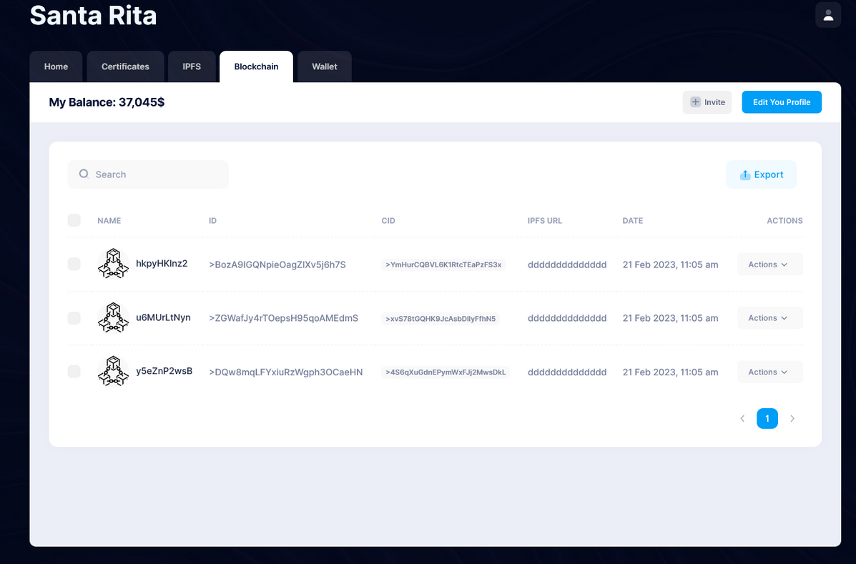
Certichain
User Interfaces

Slide 13
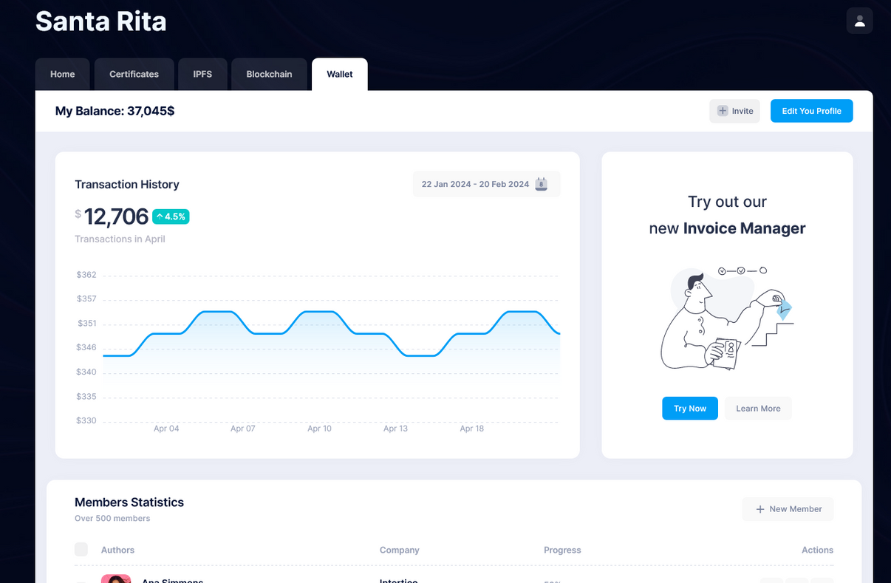
Certichain
User Interfaces

Slide 14
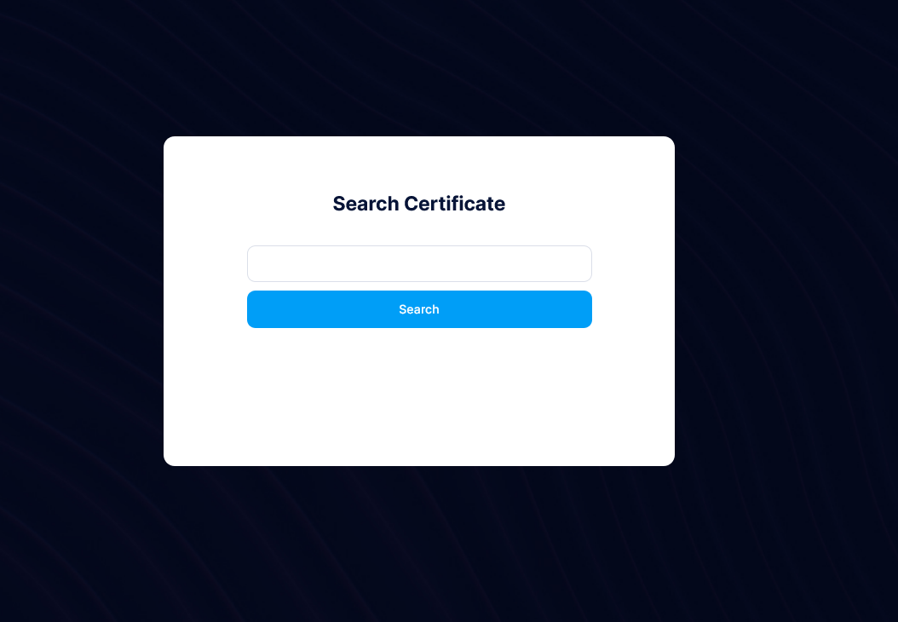
Certichain
User Interfaces

Slide 15
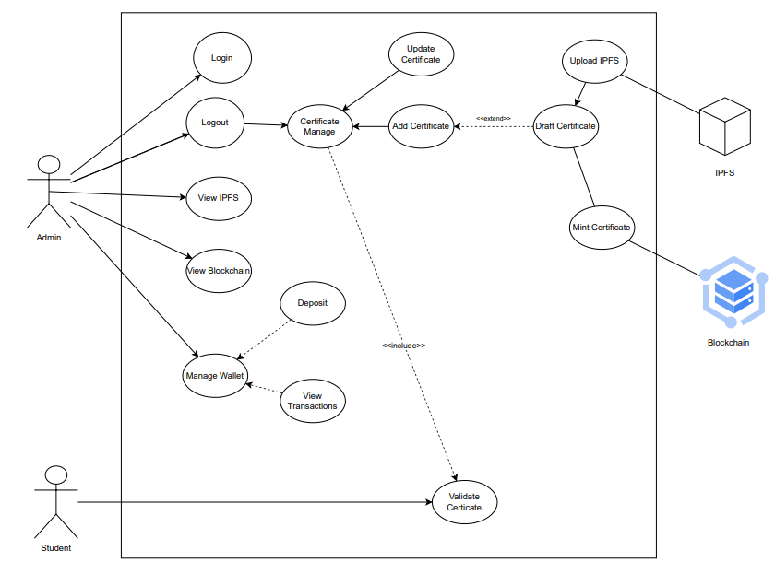
Certichain
Use
Case
Diagram

Slide 16
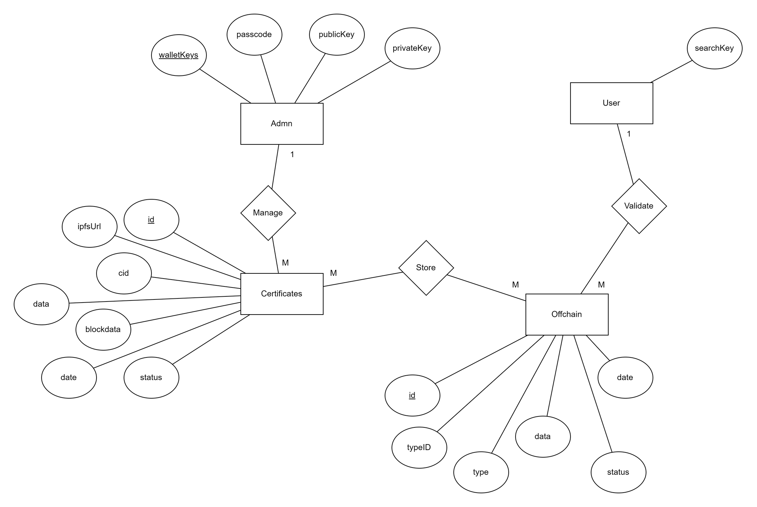
Certichain
ER
Diagram

Slide 17
Certichain
Functional Requirements
Admin:
User:
Login
Manage Certificates
Mint Certificates
View IPFS data
View Blockchain Data
Search \ View Certificate
Validate Certificate

Slide 18




Certichain
Technologies
Web programming technologies - HTML, CSS, JavaScript, PHP, jQuery & Ajax
Frameworks - Bootstrap 5
Libraries - Tatum, Font Awesome, Lottie
Database - MYSQL
Blockchain - CELO
File Storage - IPFS

Slide 19
Certichain
Operating Environment
HARDWARE REQUIREMENTS
SOFTWARE REQUIREMENT
PC
WIFI router
CPU - i3 or above
RAM - 4GB or above
Disk - 15GB Minimum
Windows 10/11
MySQL Server
Tatum CLI
XAMP
Visual Studio Code

Slide 20



Certichain
Non - Functional Requirements
Availability.
Usability.
Performance.
Security.

Slide 21
Thank You

